Slide 1


Big Data Project– Spark & Tableau
Books Rating Data
Gal Avizoor – 200866226
Email – Avizoor.gal@gmail.com

Slide 2
Data preperation - Saprk
I received 3 CSV files:
BX-Users
BX-Book-Ratings
BX-Books
In order to fix all the messy data, I deleted all the unnecessary apostrophes and then split each file with its specific delimiter via Spark.
Each file transformation was placed in different variable (3 variables for 3 csv files) as follows:
DimUsers -> BX-Users
FactRating –> BX-Book-Rating
DimBooks -> BX-Books

Slide 3
Data Preperation - Spark
I noticed that many of the rows from the Users CSV at the Country Column were wrong with many gibberish letters.
Hence the approach I decided to take is to use pycountry library which contains all the countries and with it I created a distinct list of all the countries. With that list I checked for each row if the country is in that list and if not Unknown was placed instead.
In addition, I filtered away all the null/‘n/a’/blank values from each column and dropped the unnecessary columns (City, District) by using Pyspark.

Slide 4
Data preperation - Saprk
Regarding the other variables (Books and Rating) I also cleared all the unnecessary null/’n/a’/blank and all the gibberish values by filtering them out with Pyspark.
For the Rating Variable I also created two lists for the ISBN (ID for each Book) Valid and Invalid and appended each one to its corresponding list in order to filter out the Invalid ISBNs in the data. Moreover I filtered away all the ISBNs which their characters length is different than 10 with Spark SQL.
For the last step I used Tableau Prep to join the 3 csv files and dynamically loading it with it to Tableau Desktop where the data is visualized.

Slide 5
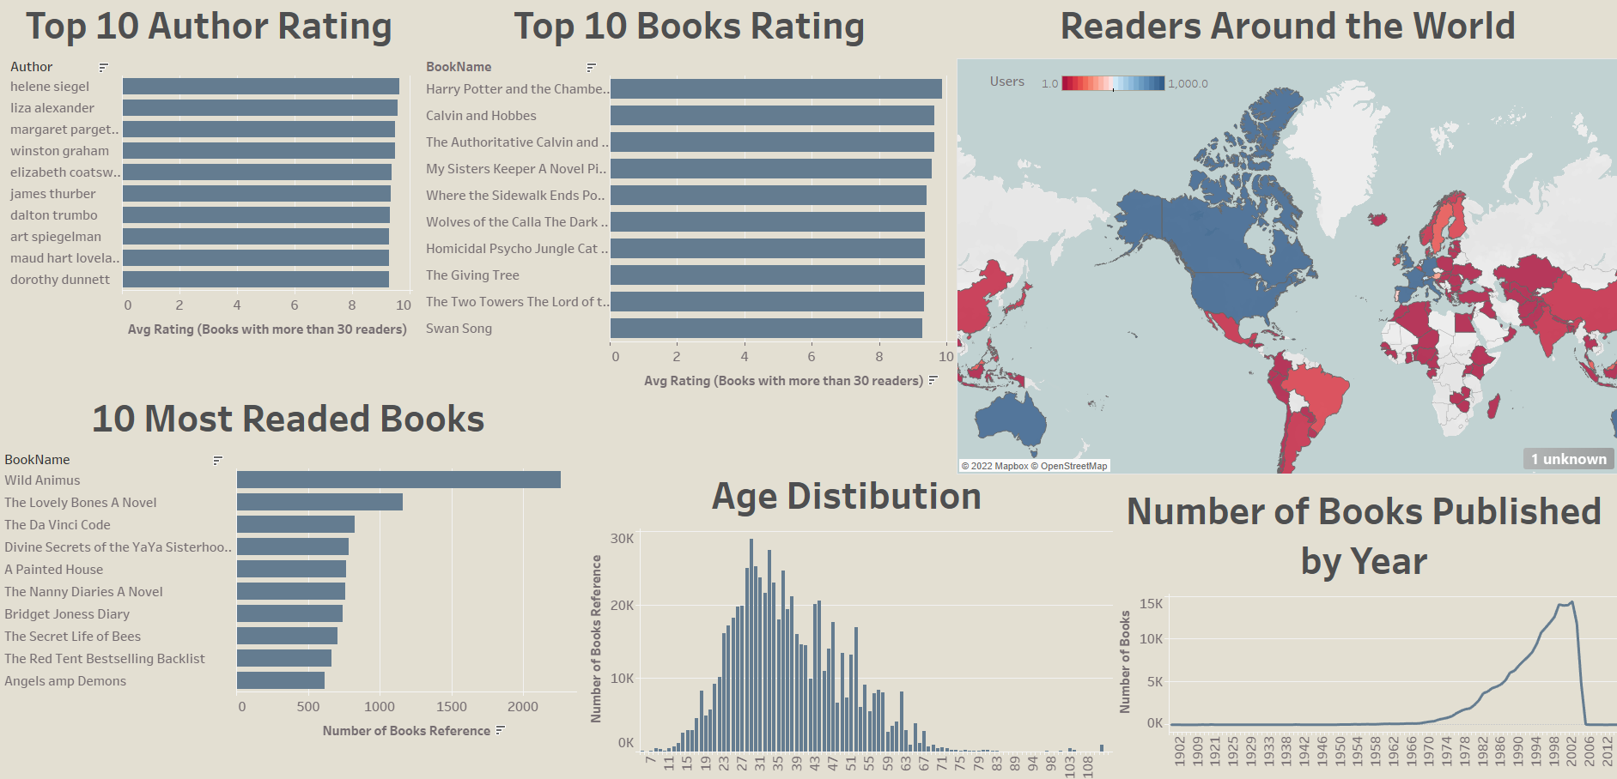
Data Visualization – Tableau Dashboard
As seen on the left, ‘Wild Animus’ is the most readed book in this data.
‘Harry Potter and the Chamber of Secrets Postcard Book’ has the highest rating in the data with above 9.8 raiting.
Helene siegel is the highest rated Author with in the data.
The Age Distribution seems to follow the normal distribution with some skew to the right
The United States is the most active country with the most unique users (52,788), number of book references of 681,013, Average age is 38.7 and the Average Rating is 7.7 . The highest rated book in the United States is ‘The Giving Tree’ with average rating of 9.65
We can see that the number of books that publishes every year within the data is growing each year and the trend changed to downward trend drastically approximately in 2004
United States

